Slide 1
Agenda
Introductions & What’s New in Azure Databricks
Modern Data Architecture with Azure Databricks & Synapse
Delta Demo & Code Along (Notebooks in https://academy.databricks.com/class/register)
Competitive Plays & Positioning
Break (~15min)
Machine Learning With Azure Databricks
Machine Learning Demo & Code Along (Notebooks in https://academy.databricks.com/class/register)
Hadoop Migrations & Vertical Plays
Wrap Up & Capstone

Slide 2
Hadoop Migration and Outcome Based Solutions with Azure Databricks

Slide 3
The Azure and Databricks partnership has a $1B+ opportunity in Data and AI in 2020.
Azure Databricks Unified Data Analytics Platform is best positioned to accelerate innovation across Data Science, Data Engineering and Business Analytics.
Better together, Azure + Databricks
Notes:
Welcome to the Databricks Overview. Thank you for joining us today.

Slide 4
Better together, but where?
Or, where is Azure Databricks a good fit?
Notes:
Welcome to the Databricks Overview. Thank you for joining us today.

Slide 5
Broadly, good Fit = Customer benefitting from ADB and being successful. From Biz 101, benefit means one or more of: 1. Customer was able to lower cost. 2. Customer was able to increase revenue. 3. Customer was able to reduce the risk.
Benefit to customer => sticky customer => soaring Azure consumption
(but not the other way around)

Slide 6
More concretely, in our world
If the tacit benefit desired by business is: | Then customer pain usually sounds like: | Azure Databricks solves the pain by: | And we call the solution pattern:
Lower cost | Help me optimize price-performance with Data Lakes and Data Warehouse. | Doing ELT cheaply with Delta Lake, sending final results to Synapse for concurrent access. | Modern Data Warehouse
 | Hadoop doesn’t work because of Small Files, inconsistent views, schema mismatches. | Moving Spark and Hive jobs over from Hadoop, making them actually work. | Hadoop migration
Increase revenue | Include novel data sources, use AI, and build cutting edge products. | Using MLFlow and Azure ML for predictive analytics and proactive | Streaming, Advanced Analytics
Reduce risk | Help me stay compliant | Processing large amounts of messy data using cutting edge security controls. | Auditing, GDPR

Slide 7
In this talk, we will discuss Hadoop, and more
If the tacit benefit desired by business is: | Then customer pain usually sounds like: | Azure Databricks solves the pain by: | And we call the solution pattern:
Lower cost | Help me optimize price-performance with Data Lakes and Data Warehouse. | Doing ELT cheaply with Delta Lake, sending final results to Synapse for concurrent access. | Modern Data Warehouse
 | Hadoop doesn’t work because of Small Files, inconsistent views, schema mismatches. | Moving Spark and Hive jobs over from Hadoop, making them actually work. | Hadoop migration
Increase revenue | Include novel data sources, use AI, and build cutting edge products. | Using MLFlow and Azure ML for predictive analytics and proactive | Streaming, Advanced Analytics
Reduce risk | Help me stay compliant | Processing large amounts of messy data using cutting edge security controls. | Auditing, GDPR

Slide 8
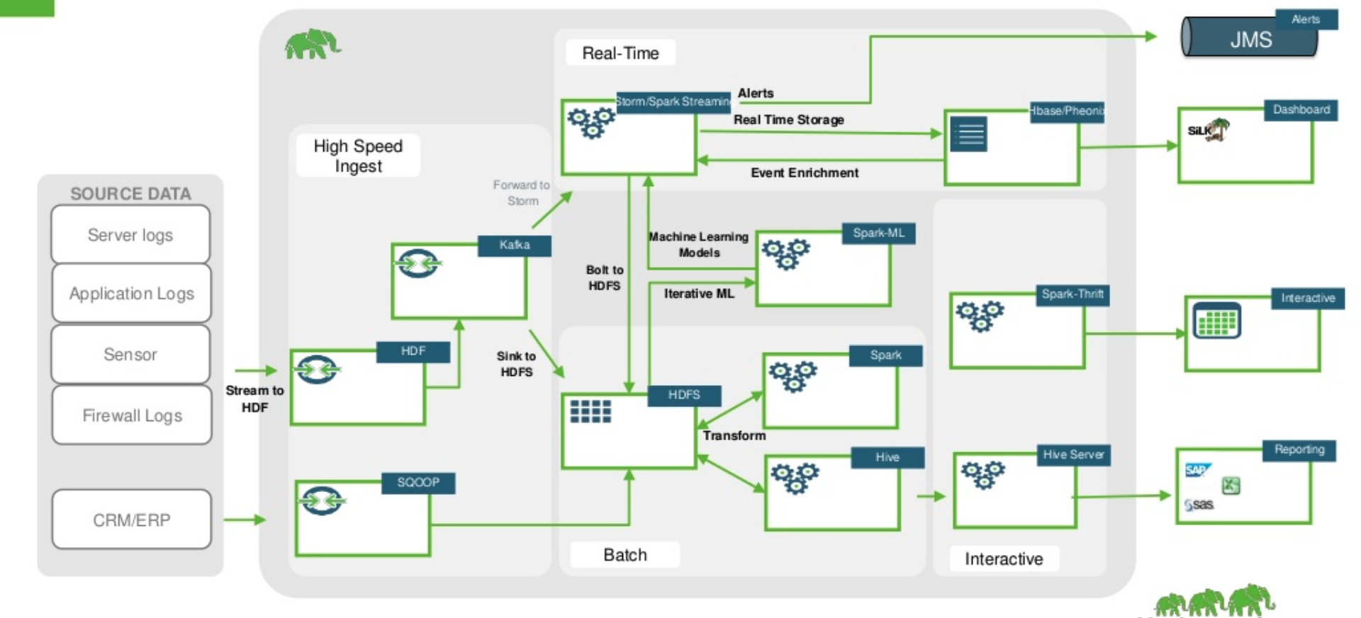
First, what is in Hadoop? (Hortonworks, now Cloudera)

Slide 9
Hadoop is a collection of Open Source Big Data storage and analytics tools, bundled in one platform with yearly license.
Customers now want to move out of it.
To understand why, let’s look at a prominent Hadoop vendor’s pitch to solve a particular problem circa 2010 over next two slides. First slide frames the problem, and the one after it, proposes some solutions.

Slide 10
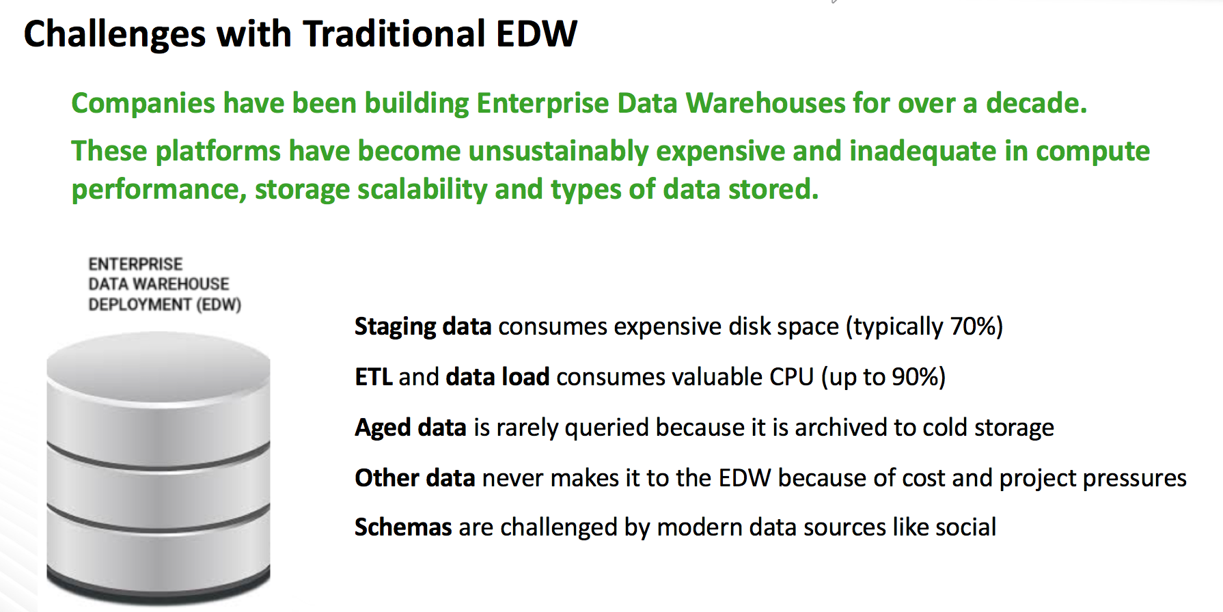
Framing the problem (taken from a Hadoop vendor’s public slides):

Slide 11
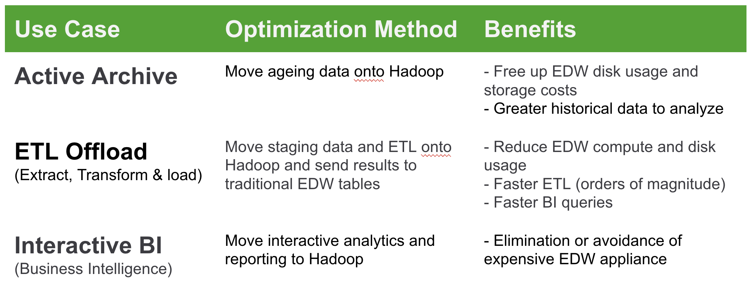
And solving it...
Look familiar?

Slide 12


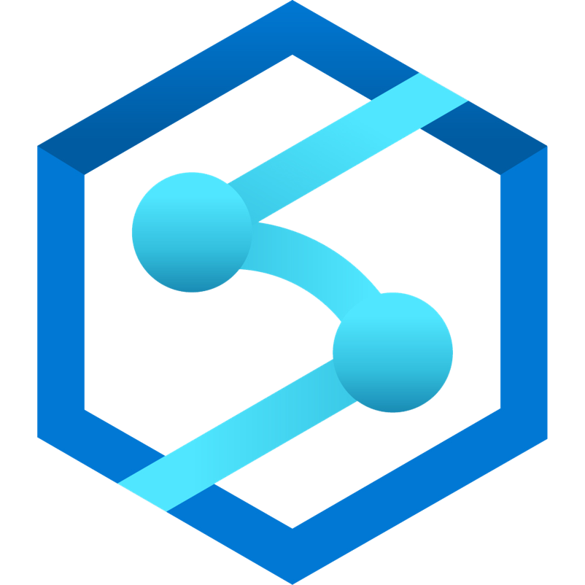
Looks similar to our modern data warehouse paradigm
(more on this later)
Ingest
Store
Prep & train
Model & serve
Logs, files and media
(unstructured)
Azure Data Lake Storage
Optimized Connector
Azure Data Factory
Azure Databricks
(Apache Spark, Delta Lake)
Power BI
Raw Format
Delta Format
Business/custom apps
(Structured)
PolyBase
Azure Synapse (DW)
- Reliability and Performance on ADLS
ACID Transaction Guarantees
Atomic, Consistent, Isolated, Durable
Versioned parquet files
Delta transaction log keeps track of all operations
Efficient Upserts
MERGE, DELETE, UPDATE
Time Travel
Audit history, pipeline debugging, data reproducibility
Small file compaction w/ no interrupt to availability
OPTIMIZE and VACUUM
Z-Order partitioning w/ up to 100x perf
New multidimensional partitioning enables data skipping
Notes:
Delta adds this layer that allow us to have both transactional and scalable metadata. 3 tricks under the cover
Standard parquet file , which spark is very fast at processing
Transaction log – tells which of this parquet file is valid, use transaction log in a way that provides ACID semantics and massive scale

Slide 13
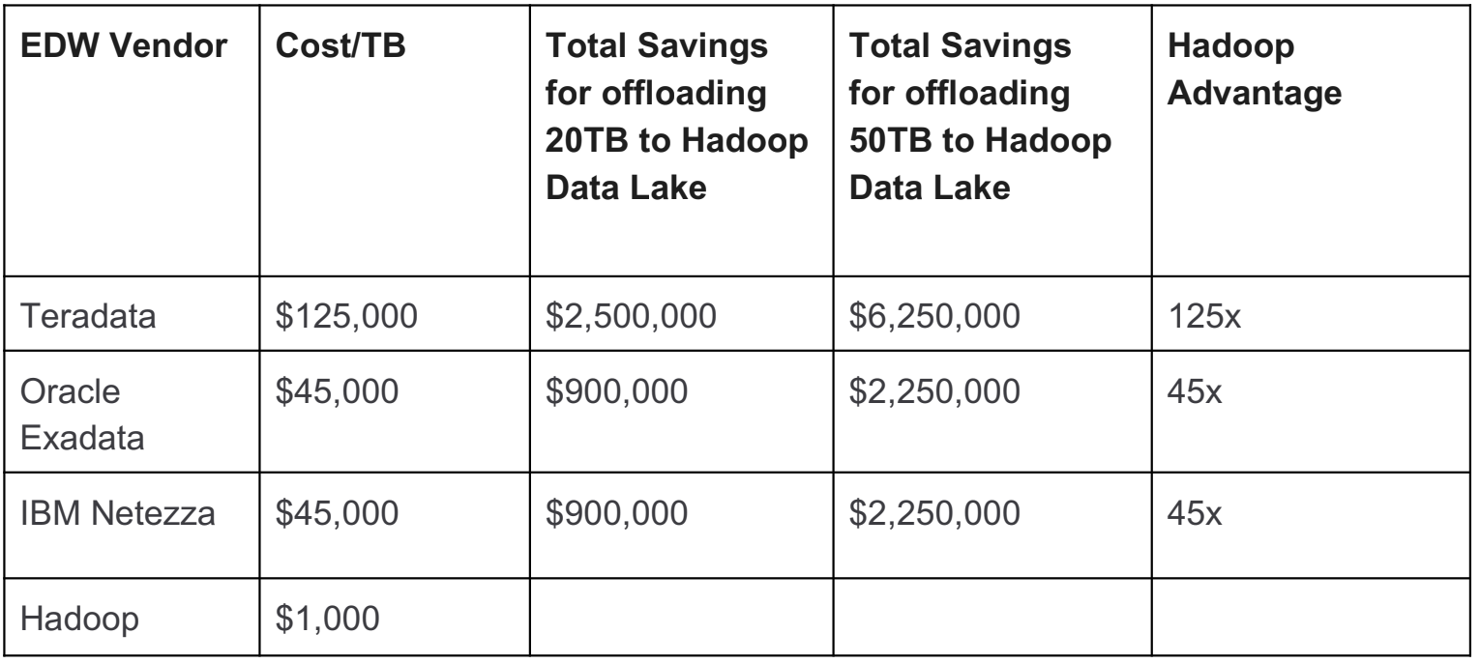
Hadoop’s main perceived benefits to customers were:
Low cost
Ability to handle new data sources (logs, social, etc)

Slide 14
But it had downsides as well
Category | Pain
Wasted resources | My large 1000 node cluster is on 24x7x365.
Poor scalability | Can’t process most of my data because Hadoop doesn’t handle small files ~10MB well. (IoT, retail apps)
Poor performance | SQL on Hadoop (Hive) is ludicrously slow. (15 hrs to get back results)
Lack of applicability to all use cases | Use cases: Can’t merge fast arriving data with historical data easily on to build new solutions. Can’t do CDC.
Unreliability | Data Quality: Can’t figure out why processing stopped. Did someone add a new field in my data stream?

Slide 15
One can think of some general solutions
Category | Pain | General Solution
Wasted resources | My large 1000 node cluster is on 24x7x365. | Decouple storage from compute, turning them off and using them only when needed.
Poor scalability | Can’t process most of my data because Hadoop doesn’t handle small files ~10MB well. (IoT, retail apps) | Pack small files into larger chunks for efficient processing.
Poor performance | SQL on Hadoop (Hive) is ludicrously slow. (15 hrs to get back results) | Switch over to a Hive compatible store with more optimizations.
Lack of applicability to all use cases | Use cases: Can’t merge fast arriving data with historical data easily on to build new solutions. Can’t do CDC. | Switch to a HDFS compatible data store which allows merging with ACID.
Unreliability | Data Quality: Can’t figure out why processing stopped. Did someone add a new field in my data stream? | Switch over to a technology which can manage schema evolution overtime.

Slide 16
But what are the solutions on Azure, specifically?
Category | Pain | General Solution | Solution On Azure
Wasted resources | My large 1000 node cluster is on 24x7x365. | Decouple storage from compute, turning them off and using them only when needed. | ?
Poor scalability | Can’t process most of my data because Hadoop doesn’t handle small files ~10MB well. (IoT, retail apps) | Pack small files into larger chunks for efficient processing. | ?
Poor performance | SQL on Hadoop (Hive) is ludicrously slow. (15 hrs to get back results) | Switch over to a Hive compatible store with more optimizations. | ?
Lack of applicability to all use cases | Use cases: Can’t merge fast arriving data with historical data easily on to build new solutions. Can’t do CDC. | Switch to a HDFS compatible data store which allows merging with ACID. | ?
Unreliability | Data Quality: Can’t figure out why processing stopped. Did someone add a new field in my data stream? | Switch over to a technology which can manage schema evolution overtime. | ?

Slide 17
To find specific Azure solutions, let’s look at it from customer’s perspective.
In customer’s mind: “What are my broad migration strategies when moving from on-prem Hadoop to Azure?”

Slide 18
Broad on-prem Hadoop to Azure migration strategies
Strategy | Mechanics | Pros | Cons | Example
Lift and Shift to Hadoop on Cloud (IaaS, pseudo PaaS etc.) | Take Hadoop cluster and run it on Azure VMs in an IaaS manner. | Easy to visualize. Can get a quick win for a PoC. | Still stuck with same Hadoop problems. Antipattern. Not taking advantage of Cloud’s core features. Customer unlikely to be successful. | Cloudera cluster on Azure IaaS VMs, direct attached disks for HDFS.
Replatform to modern data estate | Move the data layer on ADLS, move Hadoop compute to a PaaS service. | Fixes all Hadoop’s problems. Customer is successful with best price-performance. | Longer. Requires customer education and solution guidance. | Azure Databricks for compute. Decoupled HDFS Delta Lake on ADLS. Synapse for aggregated results, if needed.
Replatform back to Data Warehouse in Cloud | Remove Hadoop entirely and go for a Data Warehouse. | Fixes some Hadoop problems. Looks good with a quick PoC. | Can’t do ML, and can’t store all types of data. High cost in the long run. Customer unlikely to be successful. | Snowflake

Slide 19
So, avoid Lift and Shift, avoid needless expense (Snowflake).
Strategy | Mechanics | Pros | Cons | Example
Lift and Shift to Hadoop (IaaS, etc.) | Take Hadoop cluster and run it on Azure VMs in an IaaS manner. | Easy to visualize. Can get a quick win for a PoC. | Still stuck with same Hadoop problems. Antipattern. Not taking advantage of Cloud’s core features. Customer unlikely to be successful. | Cloudera cluster on Azure IaaS VMs, direct attached disks for HDFS.
Replatform to modern data estate | Move the data layer on ADLS, move Hadoop compute to a PaaS service. | Fixes all Hadoop’s problems. Customer is successful with best price-performance. | Longer. Requires customer education and solution guidance. | Azure Databricks for compute. Decoupled HDFS Delta Lake on ADLS. Synapse for aggregated results, if needed.
Replatform back to Data Warehouse in cloud | Remove Hadoop entirely and go for a Data Warehouse. | Fixes some Hadoop problems. Looks good with a quick PoC. | Can’t do ML, and can’t store all types of data. High cost in the long run. Customer unlikely to be successful. | Snowflake

Slide 20
Finally we arrive at specific solutions on Azure for Hadoop’s issues
Category | Pain | General Solution | Solution On Azure
Wasted resources | My large 1000 node cluster is on 24x7x365. | Decouple storage from compute, turning them off and using them only when needed. | Databricks (compute) + ADLS (storage).
Poor scalability | Can’t process most of my data because Hadoop doesn’t handle small files ~10MB well. (IoT, retail apps) | Pack small files into larger chunks for efficient processing. | Delta on ADLS to get automatic compaction of small files.
Poor performance | SQL on Hadoop (Hive) is ludicrously slow. (15 hrs to get back results) | Switch over to a Hive compatible store with more optimizations. | Delta on ADLS to get Z-ordered indexes, automatic caching, and aggressive column pruning for faster performance.
Lack of applicability to all use cases | Can’t merge fast arriving data with historical data easily to build new solutions. Can’t do CDC | Switch to a HDFS compatible data store which allows merging with ACID. | Delta on ADLS with ACID and snapshot isolation.
Unreliability | Data Quality: Can’t figure out why processing stopped. Did someone add a new field in my data stream? | Switch over to a technology which can manage schema evolution overtime. | Delta on ADLS with variable schema enforcement policies.

Slide 21
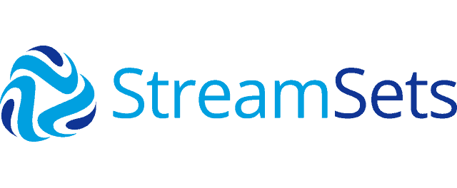




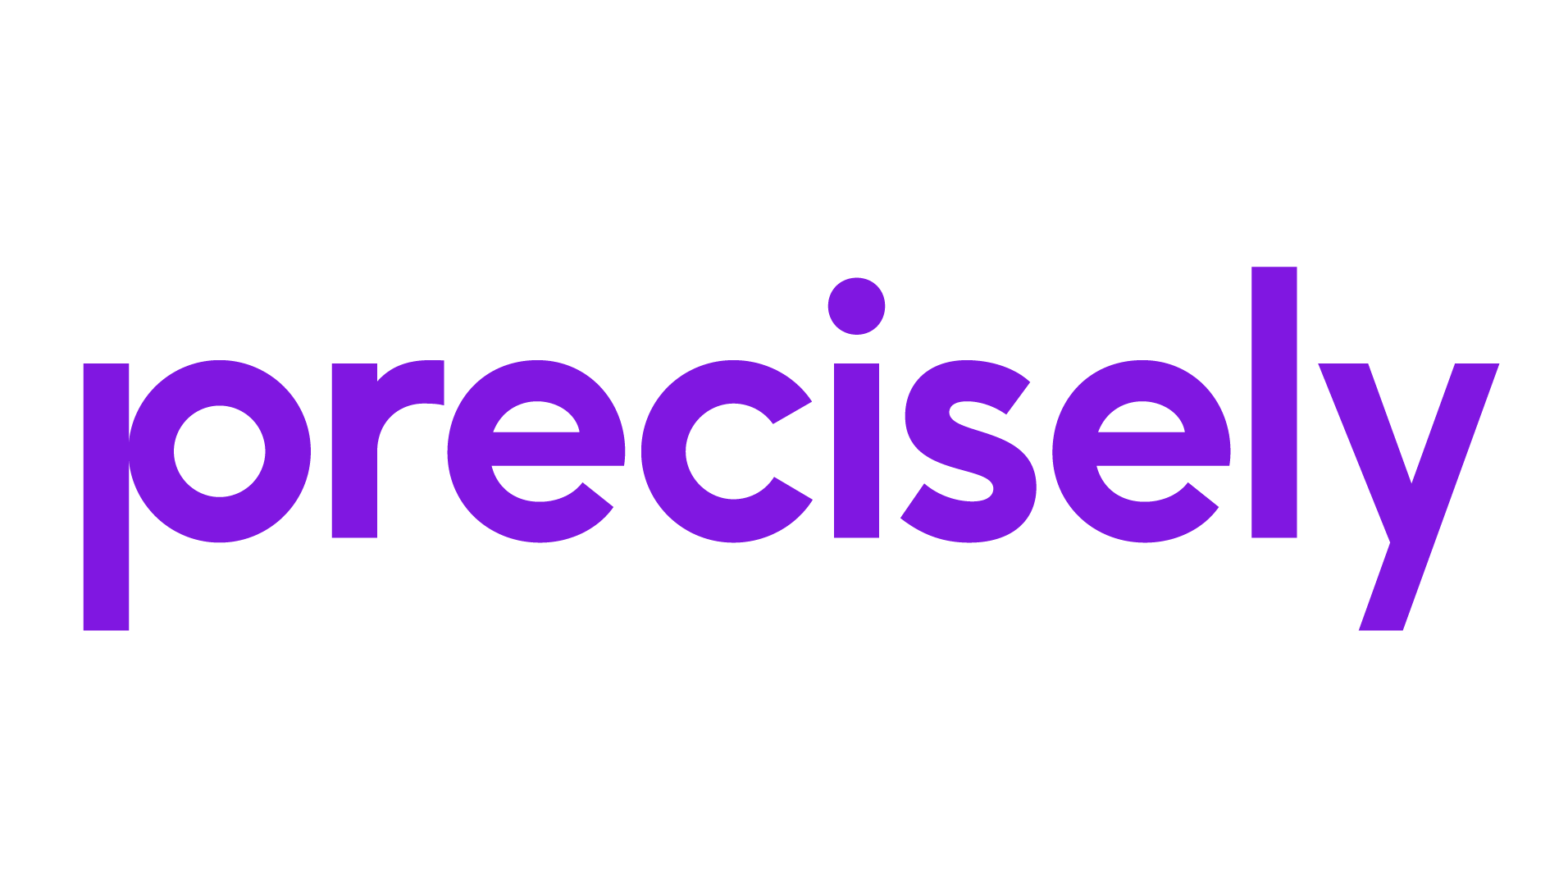
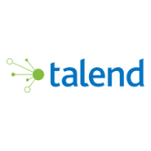

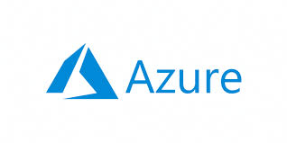

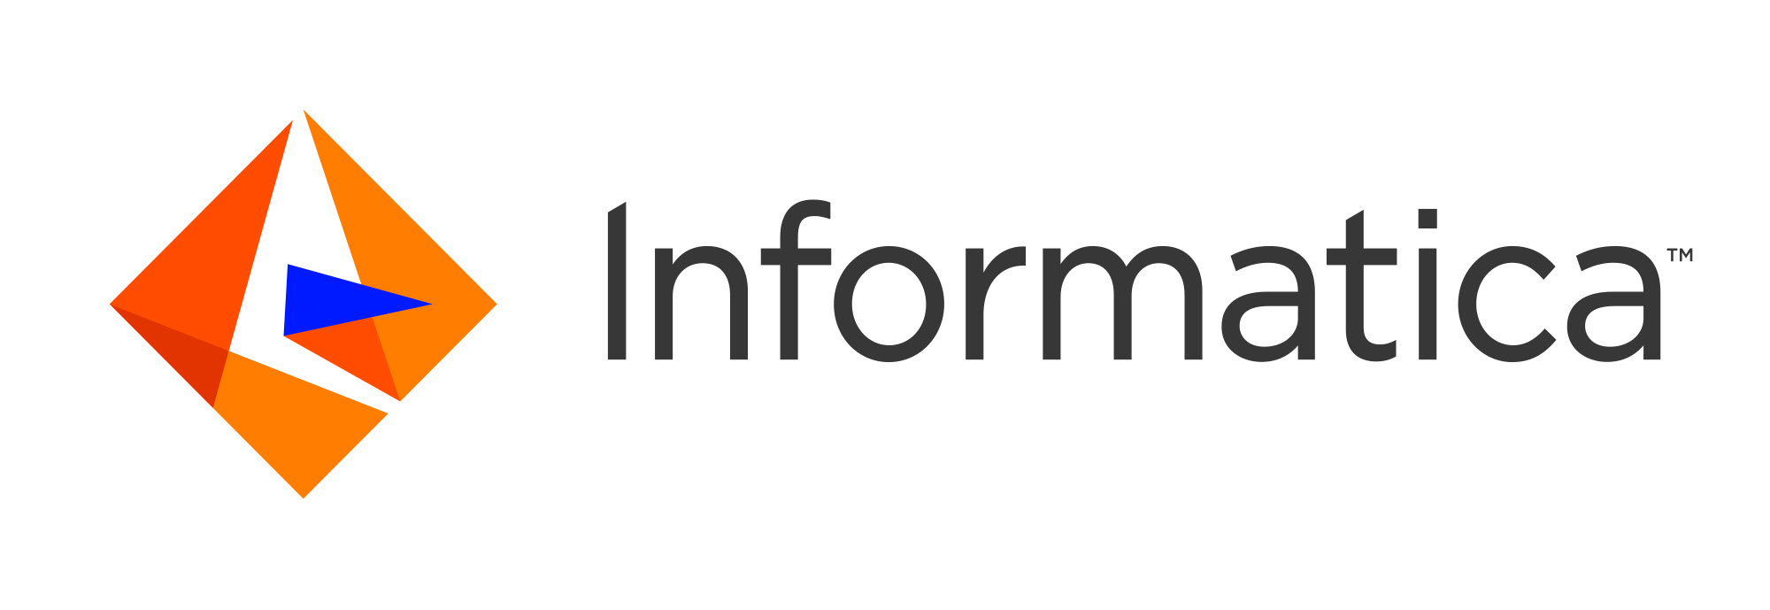


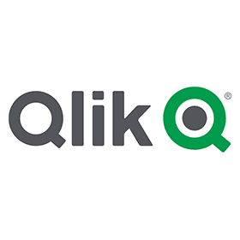


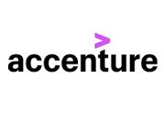





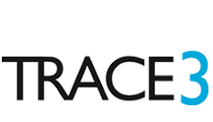
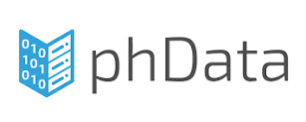

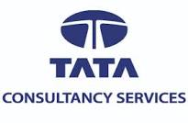




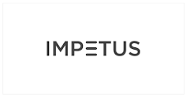
Our Partners can speed up Migrations. They help with code implementation, have specific migration tools, etc.
Security
Governance
ISV Partners and Migration Tools
Cloud
Azure Databricks
Migration
SWAT team +
CS Packaged
Services
For Migration
Consulting & SI Partners
Notes:
Dynapt/ Celebal

Slide 22
Hence, best Hadoop Migration strategy is to recreate the Data Lake on ADLS with Delta, and use Azure Databricks for compute.

Slide 23
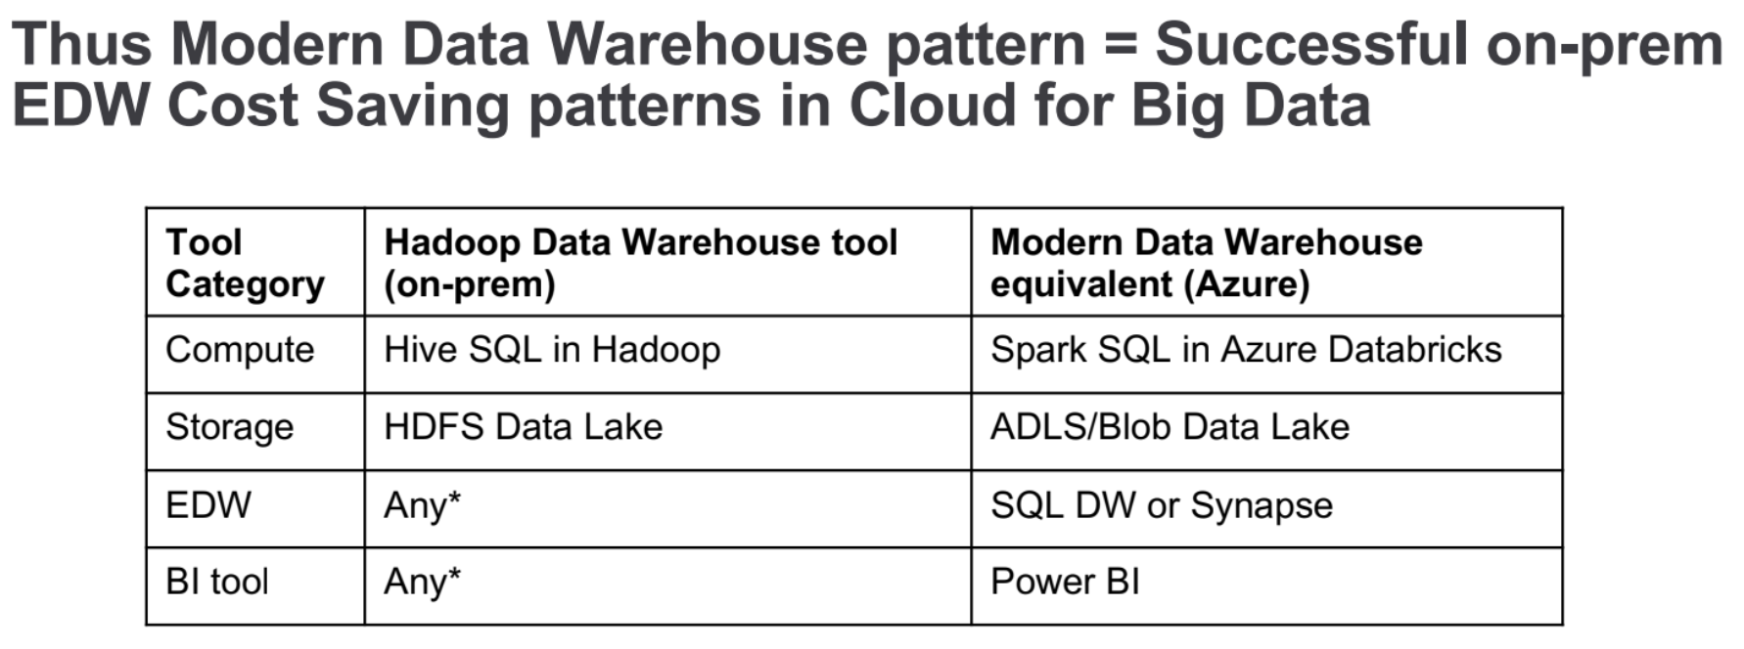

Slide 24

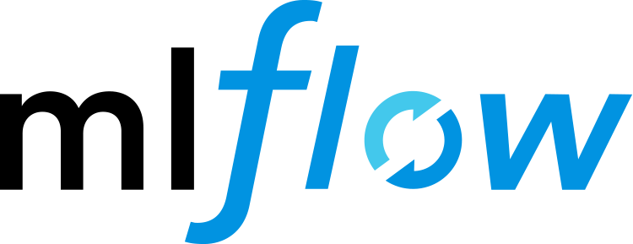

Modern Data Warehouse with Delta fixes Hadoop’s issues
Step 1
Load raw data to Azure Data Lake Storage
Step 2
Use Azure Databricks to
Combine streaming and batch
Save data as Delta format
Step 3
Use Azure Databricks to
1. Join, enrich, clean, transform data
2. Develop, train, and score ML models with Azure ML + MLFlow
Step 4
Load data into serving layers like
1. SQL Data Warehouse for enterprise BI scenarios.
2. Cosmos DB for real-time Apps
Sensors and IoT
(unstructured)
Cosmos DB
Apps
+
Logs (unstructured)
Azure Event Hub
Azure IoT Hub
Kafka
Polybase
Databricks Power BI Connector
Media (unstructured)
Files (unstructured)
Future: T-SQL on ADLS:
Azure Data Factory
Raw Format
“Raw” Delta Format
(Bronze Table)
“Enriched” Delta Format
(Silver Table)
“Refined” Delta Format
(Gold Table)
Azure Synapse Data Warehouse
Power BI
Business/custom apps
(structured)
Azure Data Lake Storage

Slide 25
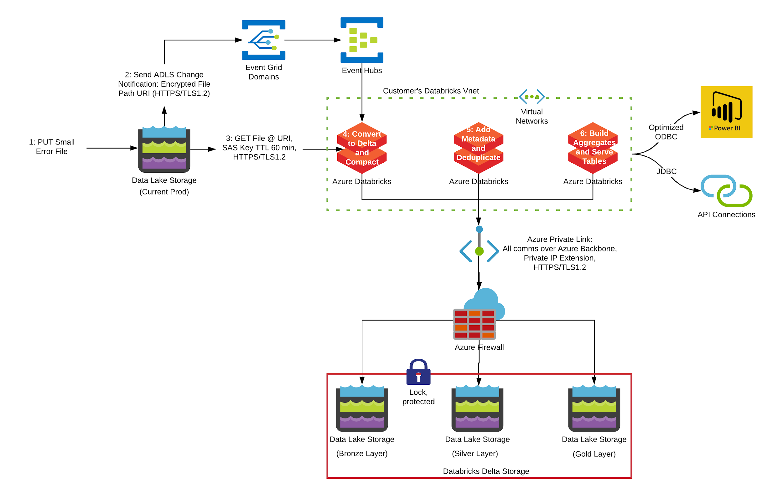
Example: fixing scalability issues (small files) at Intel with Delta’s autocompaction

Slide 26
Example: fixing performance issues at T-Mobile
T-Mobile was spending too many resources with their on-premises Hortonworks Cluster to process all call data/metadata to get critical network insights like call-failure root cause, network outages. The data was streaming in with ~2M records per second, 375GB per batch, 23 TB per day.
BEFORE - with Hive on Tez - it took 15,000 cores about ~47min to the hourly job
AFTER - With Databricks it now takes 256 cores ~35min to do the same job
KPI computation took 1/4th the time enabling lower cost and new hourly dashboards
78.5 times
more efficient
Freeing up
40% of on-prem
Infrastructure
New Hourly Dashboards
Notes:
A Tier-1 US Telco was counting on their on-premises Hortonworks cluster to process call data to get critical network insights like call-failure reasons and network outages.
The Data wasA Tier-1 US Telco was counting on their on-premises Hortonworks cluster to process call data to get critical network insights like call-failure reasons and network outages.
The Data was streaming in at an average of 2M records per second, 375GB per batch, 23 TB per day (uncompressed) streaming in at an average of 2M records per second, 375GB per batch, 23 TB per day (uncompressed

Slide 27
Examples: fixing cost overruns at numerous customers
Account | Est. Savings from Databricks | On-prem cost
Rogers Hortonworks on-prem | $4M | $7.6M
Juniper Cloudera on-prem | 870K + ~$195M NPV | $1.6M
Scribd Cloudera on-prem | $1.2M (over 3 years) | $4M (over 3 years)

Slide 28
Databricks has assisted with over 370 Hadoop migrations to the Cloud.
Everyone of them had positive TCO compared to on-prem Hadoop.
Why? (see next slide)
Notes:
Welcome to the Databricks Overview. Thank you for joining us today.

Slide 29
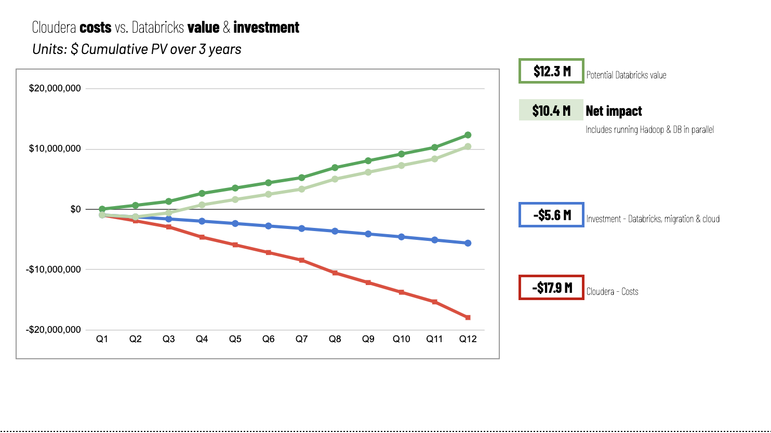

Moving to PaaS (Databricks) saves cost with reduced spending on humans managing Hadoop cluster, freeing them up to do other useful work. (taken from Gap, current migration)

Slide 30
Databricks has assisted with over 370 Hadoop migrations to the Cloud.
Because there’s so much demand, we have started a program to structure it.
Notes:
Welcome to the Databricks Overview. Thank you for joining us today.

Slide 31
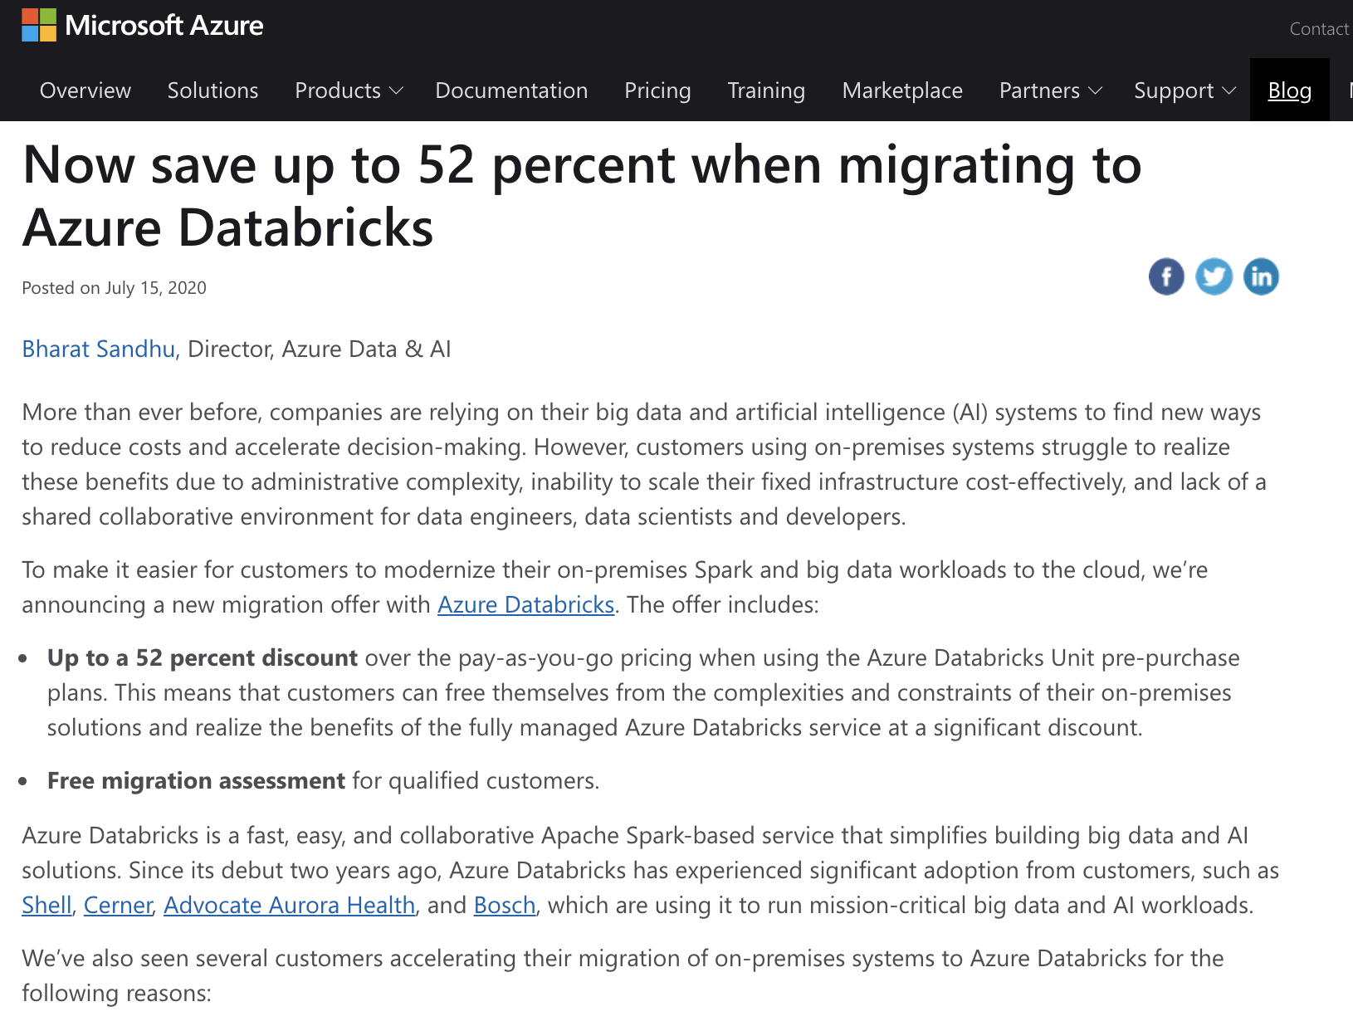
New! Save up to 52% when migrating to Azure Databricks with expert guidance
Offer summary:
Up to a 52 percent discount over the pay-as-you-go pricing when using the Azure Databricks Unit pre-purchase plans.
Free migration assessment for qualified customers.
Visit: dbricks.co/SaveUpTo52

Slide 32
Start with a two days* Hadoop Assessment workshop between customer’s IT team, Hadoop experts at Databricks, and Microsoft CSA
Identify
Prioritize
Roadmap & Value
Target State
Existing Workloads
Infrastructure and Security Requirements
Identify Priority Workloads
Dependent Schedules
Assess New Workloads
Business Value
Cloud Native Reference Architecture
Migration Schedule
Prescriptive recommendations
* can be modified to a lightweight 3 hour assessment if needed

Slide 33
Customized Hadoop Migration Success Plan
1
Pre-questionnaire + 2 day workshop led by experts
Learn about how Databricks works and how your current workloads, tools and processes map and transform in the future state in cloud
2
Technical, Use-case and Business Value analysis
High level current and future state architecture, discuss use-cases and prioritize them, understand how $$ value is driven with the migration
3
Proposal and Recommendations for path forward
The expert team will summarize all the findings and walk through the proposed costs, business value summary and recommended migration plan

Slide 34
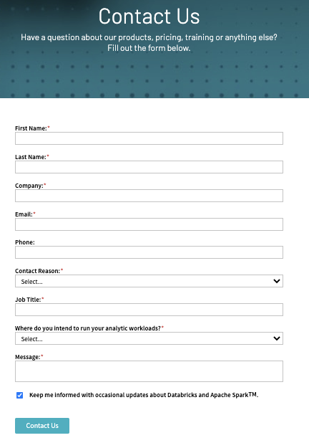
Want to start?
Contact us to schedule your free migration assessment workshop.
dbricks.co/MigrateToAzure

Slide 35
Hadoop Migrations are further accelerated by our Industry Solution experts.
They have extensive domain knowledge in their practice areas, helping customers discover new use cases as they embark on migrating Hadoop to Azure Databricks.
Next slide shows these practice areas.
Notes:
Welcome to the Databricks Overview. Thank you for joining us today.

Slide 36
Industry use cases
Financial services
Health and life science
Retail, CPG, & Ecommerce
Communications, Media & Entertainment
Energy & Utilities
Automotive
Security intelligence and threat prevention

Slide 37
To recap:
On-prem Hadoop to Azure migrations are only successful if we learn from previous mistakes and avoid antipatterns.
Delta Lakes on ADLS + Azure Databricks fix Hadoop’s issues, and make customers truly successful.
Databricks has significant experience in doing successful migrations, we have a new joint program thanks to our partnership.
Our Industry Team, partners, and in-house experts are there to help you all the way.
dbricks.co/MigrateToAzure

Slide 38
Agenda
Introductions & What’s New in Azure Databricks
Modern Data Architecture with Azure Databricks & Synapse
Delta Demo & Code Along (Notebooks in https://academy.databricks.com/class/register)
Competitive Plays & Positioning
Break (~15min)
Machine Learning With Azure Databricks
Machine Learning Demo & Code Along (Notebooks in https://academy.databricks.com/class/register)
Hadoop Migrations & Vertical Plays
Wrap Up & Capstone

Slide 39
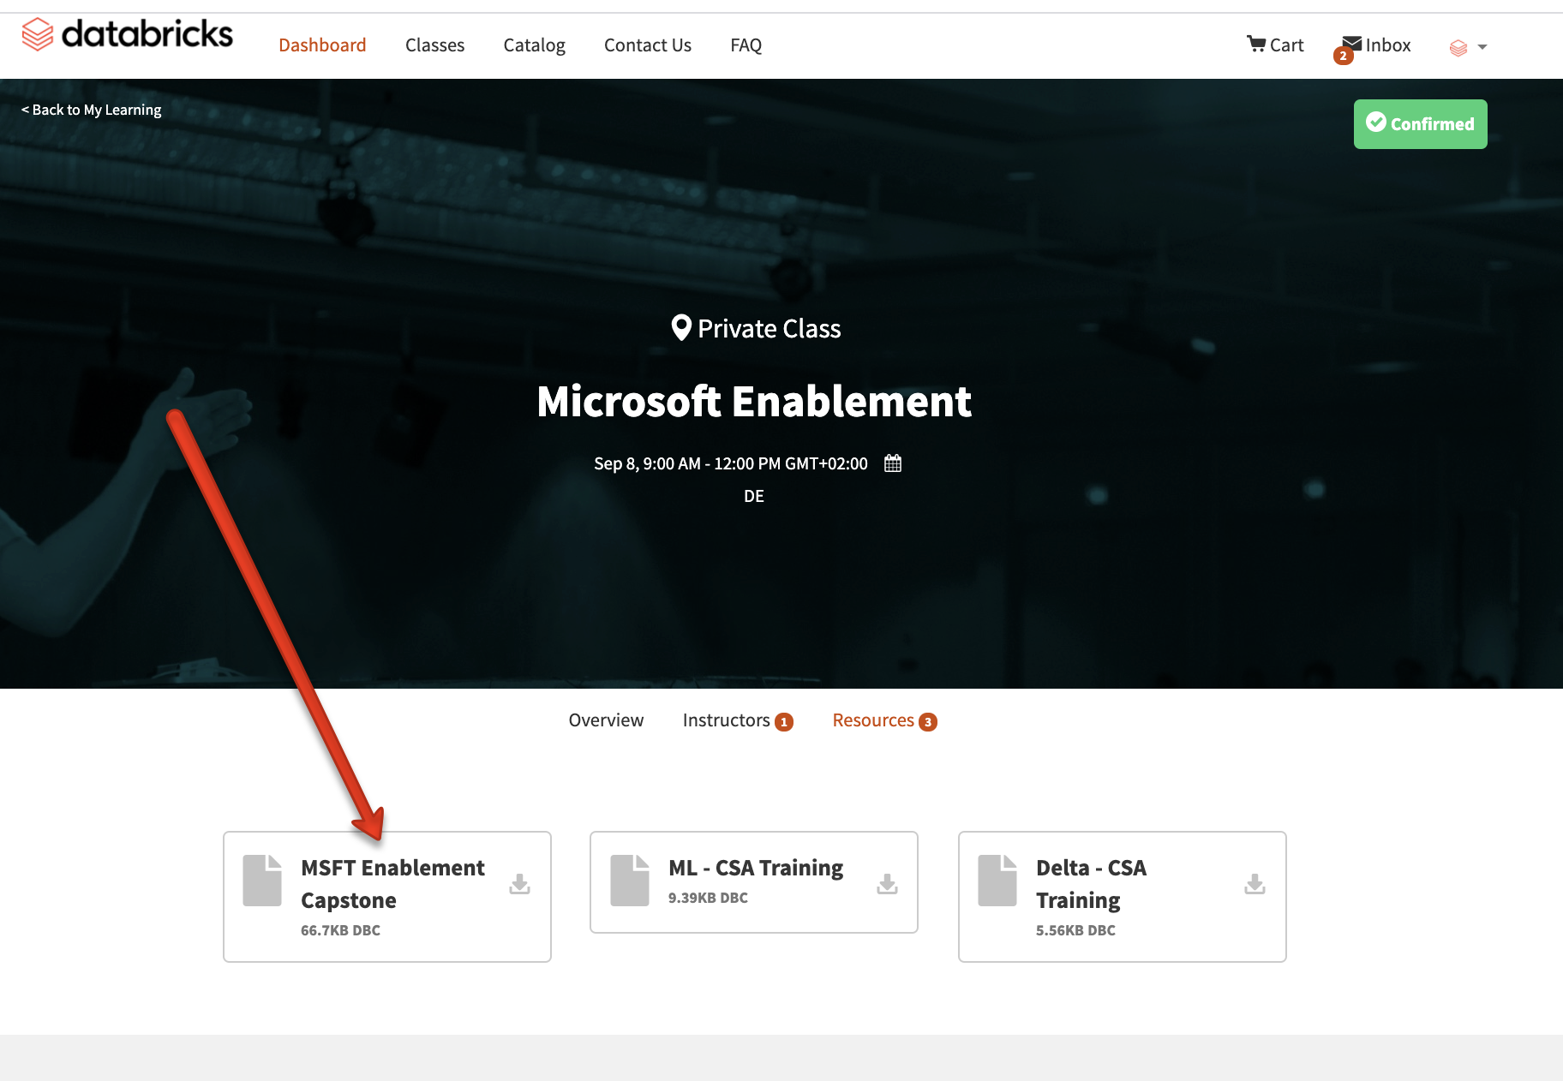
Capstone
Register - https://academy.databricks.com/class/register
Capstone Notebook (Homework) - Linked above “MSFT Enablement Capstone”
Submit finished notebook to:
adb-certification@databricks.com
Due October 1st!
Passing “Capstone” notebooks will receive the Databricks Essentials Certification and Badge

Slide 40
Capstone
Register - https://academy.databricks.com/class/register
Codes: Americas West: A1O0K9 ; Americas East: Z3J7L2; EMEA: H0M3N8; India/APAC: I0V8C1; ANZ/Japan/GCR: Q5V2W1
Capstone (Linked above in Databricks Academy)
Submit finished notebook to:
adb-certification@databricks.com
Due October 9th!
Passing notebooks will receive the Databricks Essentials Certification and Badge

Slide 41
Appendix and supporting slides

Slide 42




Financial Services
Banking/Payments
Insurance
Capital Markets
Public Sector
Customer 360
Digital Transformation
Risk Management
Regulatory Compliance
Predictive Analytics
Fraud Detection
AML
Regulatory Calculations
Marketing Analytics
Personalized Offers
Claims Automation
Actuary Science
Risk Monitoring
Predictive Risk Pricing
Optimize Brokers
IOT
Customer 360
Computer Vision
Alternative Data
Portfolio Optimization
Back-testing
Risk Management
Trading Cost Analysis
Fuzzy Matching
Automation
Regulatory Reporting
Credit Scoring
AML
Sanctions Compliance
Anomaly Detection
Economic Forecasting
Policy-making
Research
Financial Investigations
Identify Misconduct
Stress-testing
200+ use cases in Financial Services

Slide 43





Health & Life Sciences
Industry Use Cases
DNA SEQUENCES
FAST-Q , BAM, SAM, VCF, EXPRESSION
REAL WORLD ANALYTICS
HL7 / CCD, 837, PHARMACY, REGISTRY, EMR
IMAGE DEEP LEARNING
MRI, X-RAY, CT, ULTRASOUND
SENSOR DATA
READINGS, TIME SERIES, EVENT DATA
GENOMICS & PRECISION MEDICINE
CLINICAL & CLAIMS DATA
GPU IMAGE
PROCESSING
IoT DEVICE
ANALYTICS
Single Cell Sequencing
Biomarker, Genetic, Variant & Population Analytics
ADAM & HAIL on Databricks
Claims Data Warehouse
Readmission Predictions
Efficacy and Comparative analytics
Prescription Adherence
Market Access Analysis
Graphic Intensive workloads
Deep learning using Tensor Flow
Pattern recognition
Aggregation of streaming events
Predictive Maintenance
Anomaly Detection
FASTER INNOVATION FOR DRUG DEVELOPMENT
IMPROVED PATIENT OUTCOMES & COST EFFECTIVENESS
DIAGNOSTICS
LEVERAGING MACHINE LEARNING
PREDICTIVE ANALYTICS TRANSFORMS QUALITY OF CARE

Slide 44

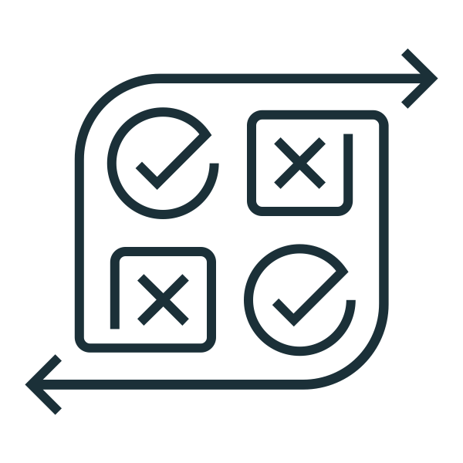



E-commerce Personalization Use Cases
Consumer 360
Propensity to Buy
Personalization
Promotions
LTV/CLV & Churn
Customer profiles, viewing history, online activity, content sources, channels
Customer profiles, online activity, content distribution, services data
Consumption logs, clickstream & devices, mktg campaign responses
Transactions, subscriptions, demographics, credit data
Content metadata, ratings, comments, social media activity
Behavioral Segmentation
Demographic Segmentation
Journey Based Segmentation
GDPR/CCPA Compliance
Propensity modeling
Demand Modeling
Demand Transference
Real time content recommendation
Cold start recommendations
Product Landing Optimization
Search enhancement
Suggested items/basket
A/B testing
Next best offer
In app offers
Real-time customer winback
Customer Lifetime Value (I & II)
Survivorship
Churn
Promotion spend analysis
Return on promotion spend
Model & find the right consumers
Identify the patterns & moments with highest likelihood of intent
Enhance user experience
with machine learning
Drive incremental revenue through targeted suggestions
Understand and retain high value customers
Linked items are available today
Bold items are included in current Q3 solution accelerator roadmap.

Slide 45
Retail - Supply Chain Inventory Optimization
Real-time Inventory
Demand Forecasting
Returns Prediction
Safety Stock
On-Shelf Availability
Provide visibility to inventory from across multiple source systems.
Improve accuracy in understanding customer demand.
Reduce the likelihood of returned items.
Reduce excess inventory and avoid lost sales from inventory disruptions.
Ensure product is available to customers.
L100 Data engineering in Delta
Basic PowerBI integration
Basic Tableau integration
Demand forecasting with causal factors
Time-series forecasting
L100 Returns prediction
Safety Stock notebook
L100 On Shelf Availability
L100 Publish to API
Single point of truth for inventory status
Reduce shrink, spoilage and lost sales
Minimize rehandling and disposal costs
Improve working capital
Avoid lost sales and brand reputation
Linked items are available today
Bold items are included in current Q3 solution accelerator roadmap.

Slide 46



Energy & Utilities
Digital Energy (Oil)
Field / Production
Supply /
Generation
Transmission & Distribution
Customer /
Retail
Autonomous Driller (Geo)
Geospatial & Seismic Data
Lease Operating Expenses
Decline Curve Analysis
Intelligent Well
Seismic processing
Cyber geosteering
Production Forecasting
Sub-surface databases
Land Acquisition
Pipeline Monitoring
Smart Grids and Microgrids
Rock & Fluid substance
Global Asset performance
Demand Forecasting
Preventive Equipment maintenance
Inventory Management
Trade Monitoring
Truck & Delivery Optimization
Vendor Management - Construction, Transportation,
Asset Optimization
Smart energy / meter
Retail Data Platform- marketing, demand side programs, operations
Energy consumption by room, devices
Packaging & selling data to insulation companies
Real time customer billing
100+ use cases in Energy & Utilities

Slide 47
Communications, media, and entertainment
Personalized recommendations
Customer profiles, viewing history, online activity, content sources, channels
Effective customer retention
Customer profiles, online activity, content distribution, services data
Information optimization
Consumption logs, clickstream and devices, marketing campaign responses
Inventory allocation
Transactions, subscriptions, demographics, credit data
Consumer engagement analysis
Content metadata, ratings, comments, social media activity
Content
personalization
Customer churn
prevention
Recommendation
engine
Predictive
analytics
Sentiment
analytics
Personalized viewing and engagement experience
Click-path optimization
Next best content analysis
Improved real time ad targeting
Quality of service and operational efficiency
Market basket analysis
Customer behavior analysis
Click-through analysis
Ad effectiveness
Content monetization
Fraud detection
Information-as-a-service
High value user engagement
Predict audience interests
Network performance and optimization
Pricing predictions
Nielsen ratings and projections
Mobile spatial analytics
Demand-elasticity
Social network analysis
Promotion events time-series analysis
Multi-channel marketing attribution
Faster innovation for
customer experience
Improved consumer outcomes and increased revenue
Enhance user experience with machine learning
Transform growth with predictive analytics
Improved consumer engagement with machine learning

Slide 48
Advertising and marketing
Effective customer engagement
Customer profiles, online history, transaction data, loyalty
Recommendation engine
Customer segmentation, CRM data, credit data, market data
Risk and fraud analysis
Transaction data, demographics, purchasing history, trends
Campaign reporting analytics
CRM, merchant records, products, services, marketing data
Brand promotion and customer experience
Social media, online history, customer service data
Customer value
analytics
Next best and
personalized offers
Risk and fraud
management
Sales and campaign optimization
Sentiment
analytics
Customer 360, segmentation
Aggregation and attribution
Audience modelling
Reduce customer churn
Insights for new products
Right product, promotion, at right time
Real time ad bidding platform
Personalized ad targeting
Real-time anomaly detection
Fraud prevention
Customer spend and risk analysis
Data relationship maps
Optimizing return on ad spend and ad placement
Multi-channel promotion
Ideal customer traits
Optimized ad placement
Opinion mining/ social media analysis
Deeper customer insights
Customer loyalty programs
Shopping cart analysis
Faster innovation for
customer experience
Improved customer outcomes and increased revenue
Risk management with
machine learning
Predictive analytics transforms growth
Improved customer engagement with machine learning

Slide 49





Telecom
Effective customer engagement
Customer profiles, credit history, transaction data, LTV, loyalty
Decision services management
Customer segmentation, CRM/click/location/device data
Churn reduction
Customer usage, transactions, complaints, CDRs, social media
Risk and revenue management
CRM, credit, risk, merchant records, products, services
Improved customer experience
Devices, OSS/BSS, networks, locations, app usage, plans, etc.
Customer value analytics
Data and network management
Churn analysis and prediction
Fraud
management
Asset and capacity management
Customer 360 / KYC
Customer rewards/loyalty
Insights for new revenue streams/products
Insights for new revenue streams/products
Better business decisions
Sell anonymous customer data for predictive insights
Predictive risk of defecting
Personalize based on micro segmentation
Network failures/call drops
Identify fraudulent use of SIM cards
CDR analysis, fraud claims, unauthorized devices, payments
Customer data protection
Predictive asset maintenance
QoS predictive modeling
Real-time CDR analysis
Faster innovation for
customer experience
Improved customer outcomes and increased revenue
Early detection of customer value loss with ML
Enhanced customer experience with machine learning
Better operational intelligence
with machine learning

Slide 50

Auto
Improved in-car productivity
Driving, congestion, parking, location, biometrics, incidental/collision, fuel consumption, commercial data
Supply chain & insurers disruption
Location, driving, infotainment, sales, inventory, driver profile, DMS, CRM
Drive customer lifetime value
400+ sensors, driver behavior, speed, wear & tear, commercial data
Actionable customer segments
Dealer management systems, CRM data, improve retailing experience
Passenger safety
Operational data 1TB/hour, 4TB/day, GPS receivers, computers, sensors, cameras, LiDAR, crowdsource
Connected
car/fleet
Network & services management
Fleet
management
Manufacturing
value chain
Autonomous
cars
Telematics & predictive maintenance
Remote driver assistance
Advanced navigation- predicting road conditions
Customer insights & engagement
Connect car driving suggestions
Personalized offers
Usage-based insurance
Supply chain optimization
Forecasting efficiency
Individual ad targeting
Advanced remote diagnostics with proactive counted measures
Automatic collision assistance
Customer-driven infotainment
Personalized insurance/claims/ recall management
Sales trends & transaction analytics
Improved retailing experience
Marketing spend optimization
Predictive asset and inventory quality and recall management
Passenger safety
Predicting journey issues- traffic, route, weather, etc.
Predictive maintenance analytics
Integration with Edge Analytics
Remote control and command
Faster innovation for
efficiency & driver retention
Improved management of risk and driving growth
Consistent personalized experience in all channels
Predictive analytics generate exponential value
Improved consumer engagement with machine learning

Slide 51
Security intelligence and threat prevention
Actionable threat intelligence
Firewall logs, network logs, network flows, authentications
Risk and fraud analysis
Network/firewall logs, web/app logs, social media content
Compliance management
Log files from network, firewall, web, applications, devices, OS
Identity and access management for analytics
Files, tables, clusters, reports, dashboards, notebooks
Security controls to leverage all data
Logs from firewall, network, apps, data access layers
Security
intelligence
Fraud detection and prevention
Security compliance reporting
Fine-grained data
analytics security
Cyber security and
predictive analytics
Real-time data correlation
Anomaly detection
Security context, enrichment
Offence scoring, prioritization
Security orchestration
e-Tailing
Inventory monitoring
Social media monitoring
Phishing scams
Piracy protection
Ad-hoc/historic incident reports
SOC/NOC dashboards
Deep OS auditing
Data loss detection in IoT
User behavior analytics
Role-based access controls
Auditing and governance
File integrity monitoring
Row level and column level access permissions
Prevention of DDOS attacks
Threat classifications
Data loss/anomaly detection in streaming
Cybermetrics and changing use patterns
Faster innovation for
threat prevention
Risk management with machine learning
Improved visibility
transforms security
Limit malicious insiders to transform growth
Prevent complex threats with machine learning

